Slide 1





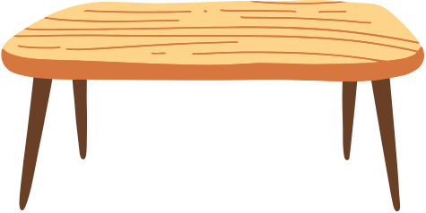
Class Agenda
Grade 2A

Slide 2
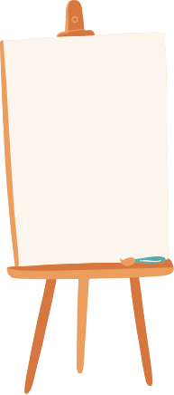



Good Morning!
Welcome to Our Wonderful Day! Today, we embark on a day full of exciting learning adventures. I'm thrilled to see all your smiling faces as we explore and discover together. Get ready for a fantastic journey!

Slide 3





Circle Time
Let's Gather in a Circle! Circle time is a special moment where we come together as a class family.
We'll share stories, discuss our plans for the day, and build a strong sense of community. Everyone's voice is important, so let's enjoy this time together!

Slide 4


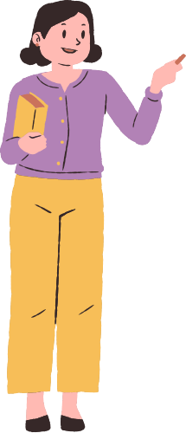

Basic Math: Numbers
Numbers are Fun! Today, we dive into the exciting world of numbers.
We'll learn about counting, identifying numbers, and maybe even do a little counting dance! Get ready for a math adventure that's both educational and entertaining.

Slide 5
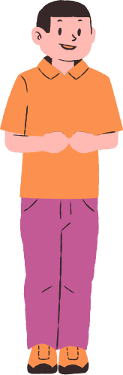

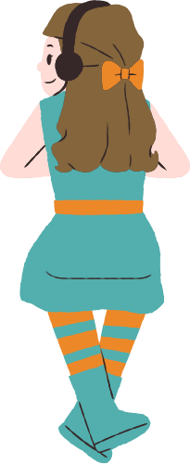
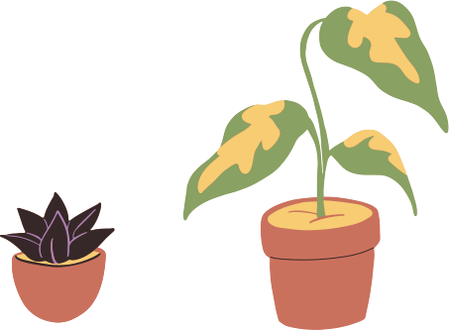



Playing Time
Let's Play and Learn! Play is a crucial part of our learning journey.
Through games and activities, we'll reinforce what we've learned, develop important social skills, and, most importantly, have a whole lot of fun together!

Slide 6

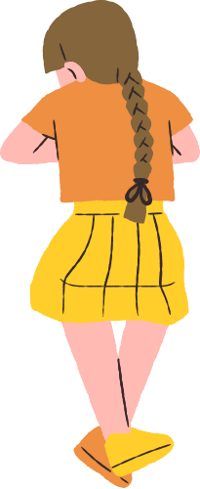


Unleash Your Creativity with Origami! Today's art session is all about origami, the ancient art of paper folding.
Get ready to create beautiful things with your hands and let your imagination soar. Origami is not just an art form; it's a wonderful way to improve focus and fine motor skills.
Visual Arts: Origami

Slide 7



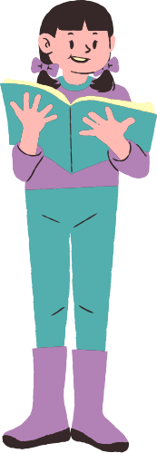

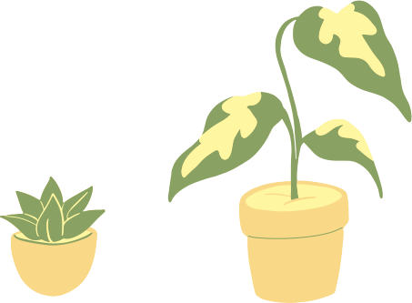
Reading Time
Journey into the World of Books! Grab your favorite reading spot because it's time to dive into the magical world of books.
Reading not only opens doors to new worlds but also enhances our language skills. Let's enjoy some captivating stories together!

Slide 8
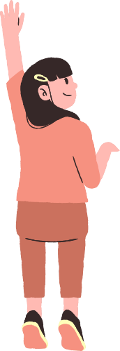
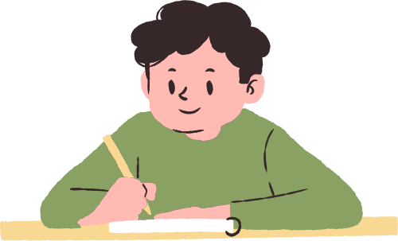
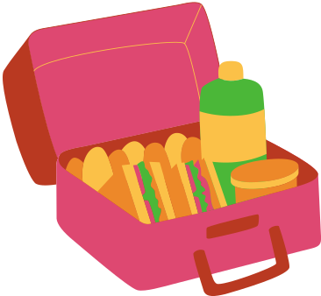



Lunch Time
Time to Refuel! It's lunchtime, a moment to refuel our bodies and chat with friends.
Remember to be mindful of healthy choices, and if there's something exciting happening during lunch today, we'll make sure to let you know. Enjoy your meal!

Slide 9

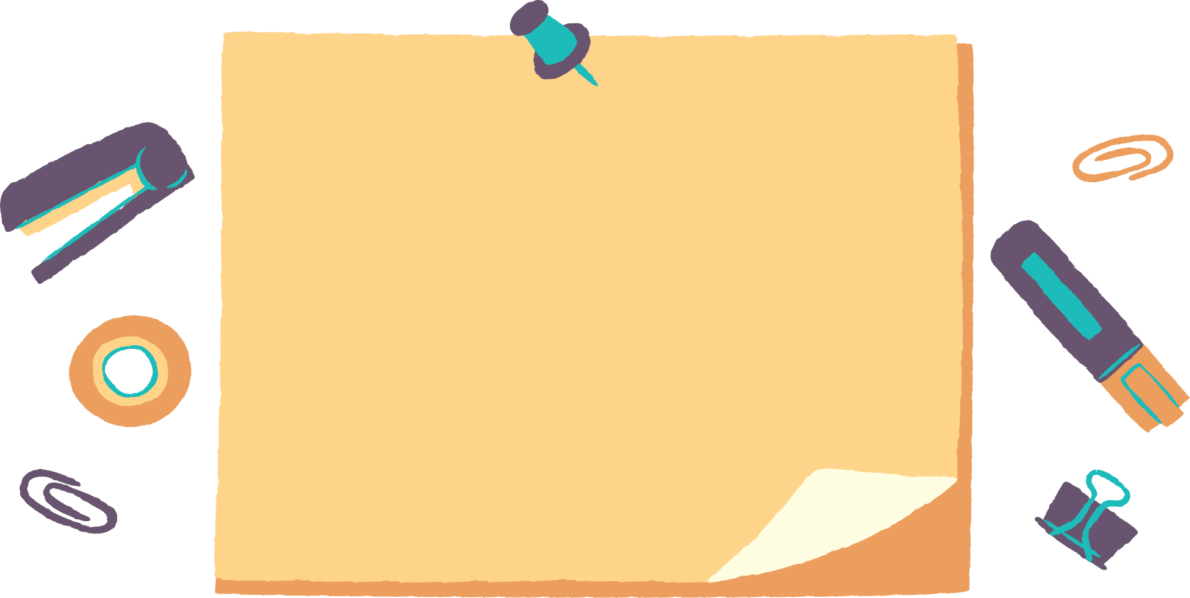

English: Elements of the Story
Exploring the Elements of a Story. Today in English, we'll embark on a storytelling adventure.
We'll learn about characters, settings, and plots—the building blocks of every great story.

Slide 10
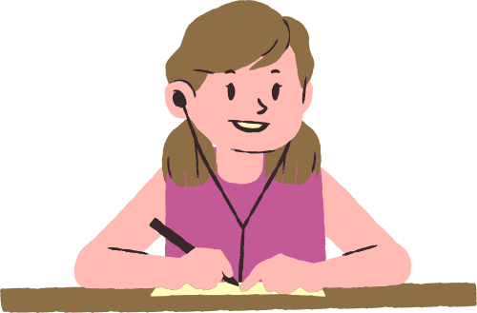
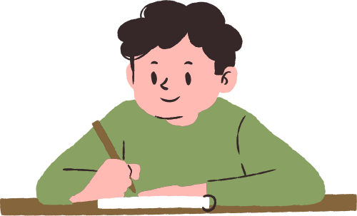

Closing Assembly
Saying Goodbye for Now! As our day comes to a close, let's take a moment to reflect on all the amazing things we've learned and shared.
Thank you for your enthusiasm and active participation. Until next time, have a wonderful day ahead, and remember, learning is an ongoing adventure!

Slide 11


Reminders
Get ready to make a splash tomorrow with swimming class! Don't forget to pack your mermaid tail or swim trunks.
Also, make sure to remind your parents to sign the Parents-Teachers Meeting confirmation. Can't wait to see you make waves!

Slide 12
om reportlab.lib.pagesizes import letter
from reportlab.pdfgen import canvas
from pdf2image import convert_from_path
import io
logging.basicConfig(level=logging.DEBUG)
logger = logging.getLogger(__name__)
def convert_to_pdf(input_file, output_pdf):
logger.debug(f"Converting {input_file} to PDF: {output_pdf}")
file_type = magic.from_file(input_file, mime=True)
try:
if file_type == 'application/vnd.openxmlformats-officedocument.presentationml.presentation':
# Convert PowerPoint to PDF
prs = Presentation(input_file)
pdf = canvas.Canvas(output_pdf, pagesize=letter)
for slide in prs.slides:
pdf.setFont("Helvetica", 12)
y = 700
for shape in slide.shapes:
if hasattr(shape, 'text'):

Slide 13


Slide 14

import PyPDF2
import re
def run_deterministic_checks(slide_data, conference):
results = []
# Check file type
file_type = slide_data['type']
results.append({
'check': 'File type',
'passed': file_type in ['pdf', 'powerpoint', 'libreoffice', 'canva', 'google_slides'],
'message': f'File type is {file_type}.'
})
# Check number of slides
num_slides = slide_data['num_slides']
results.append({
'check': 'Number of slides',
'passed': num_slides <= conference.max_slides,
'message': f'The deck has {num_slides} slides. Maximum allowed for this conference is {conference.max_slides} slides.'
})

Slide 15

Welcome to the new world its cool

Slide 16




Thank You!

